Slide 1



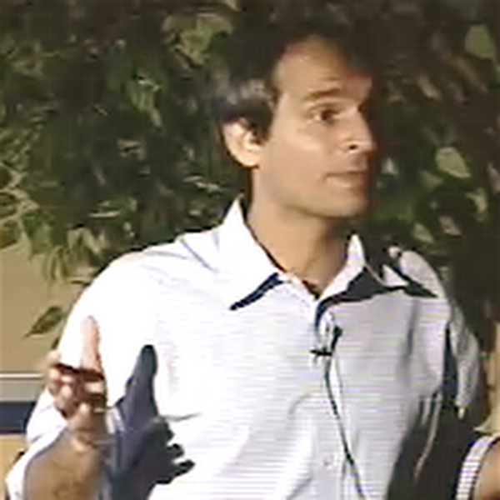


Swap Regret and Correlated Equilibria Beyond Normal-Form Games
Eshwar Ram Arunachaleswaran, Natalie Collina, Yishay Mansour, Mehryar Mohri, Jon Schneider, Balasubramanian Sivan

Slide 2

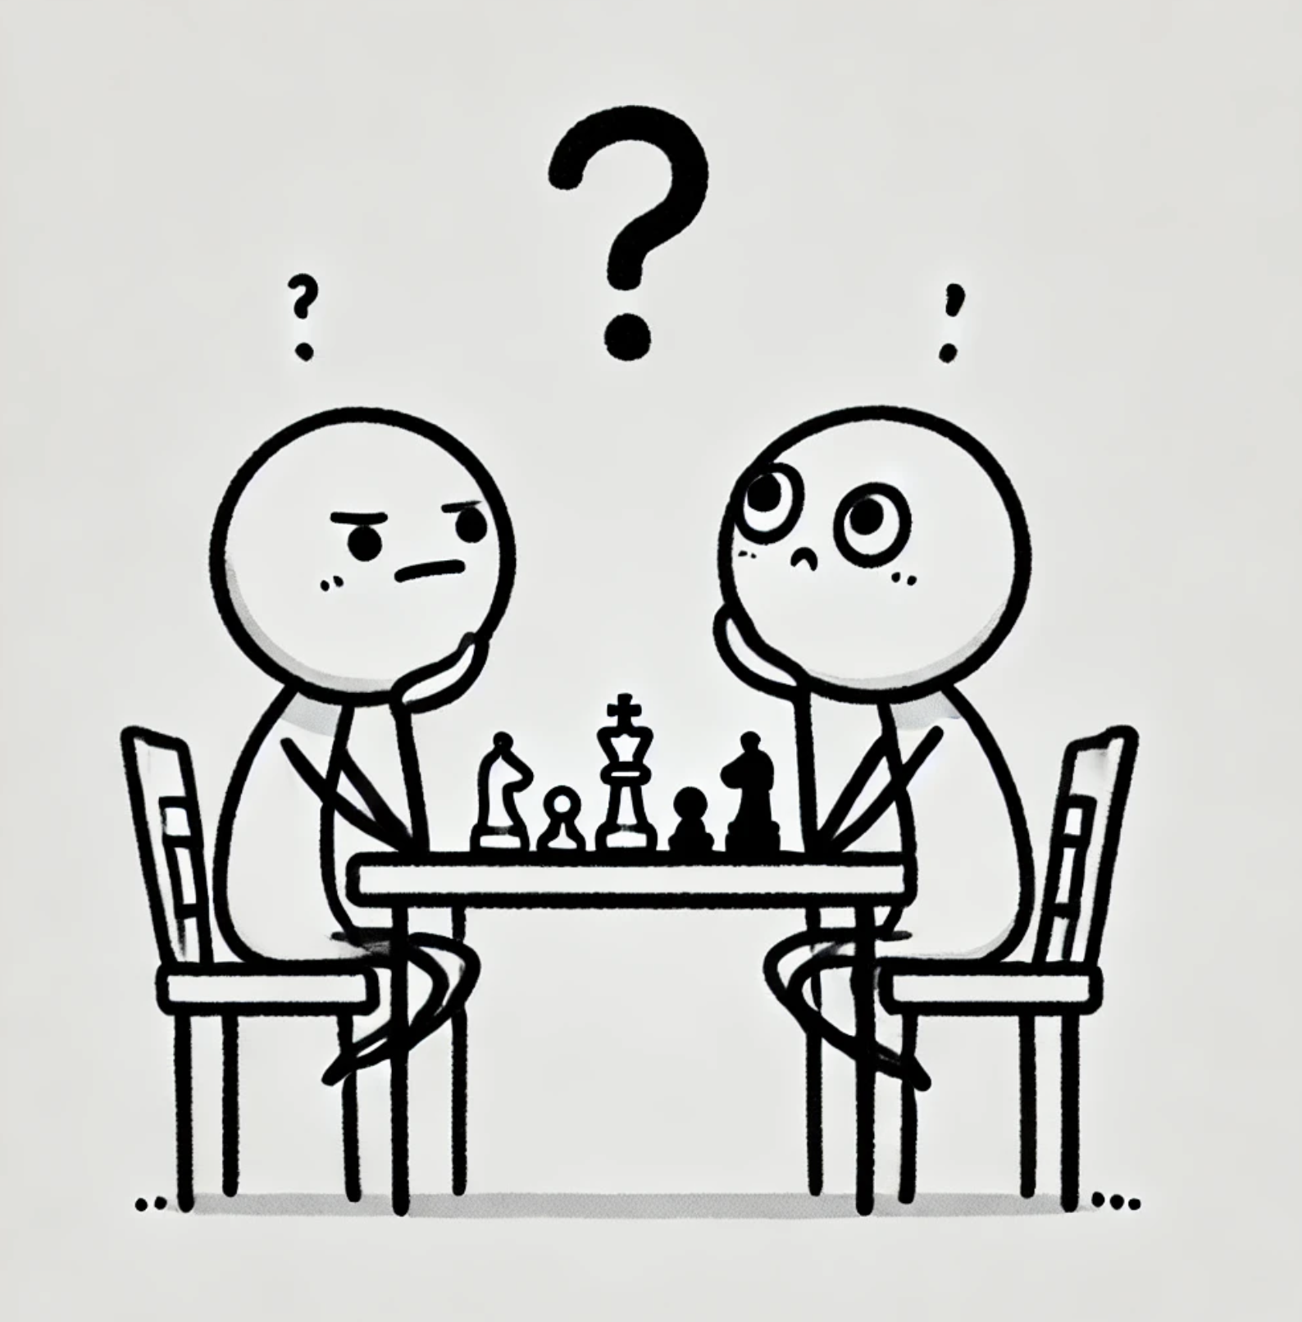

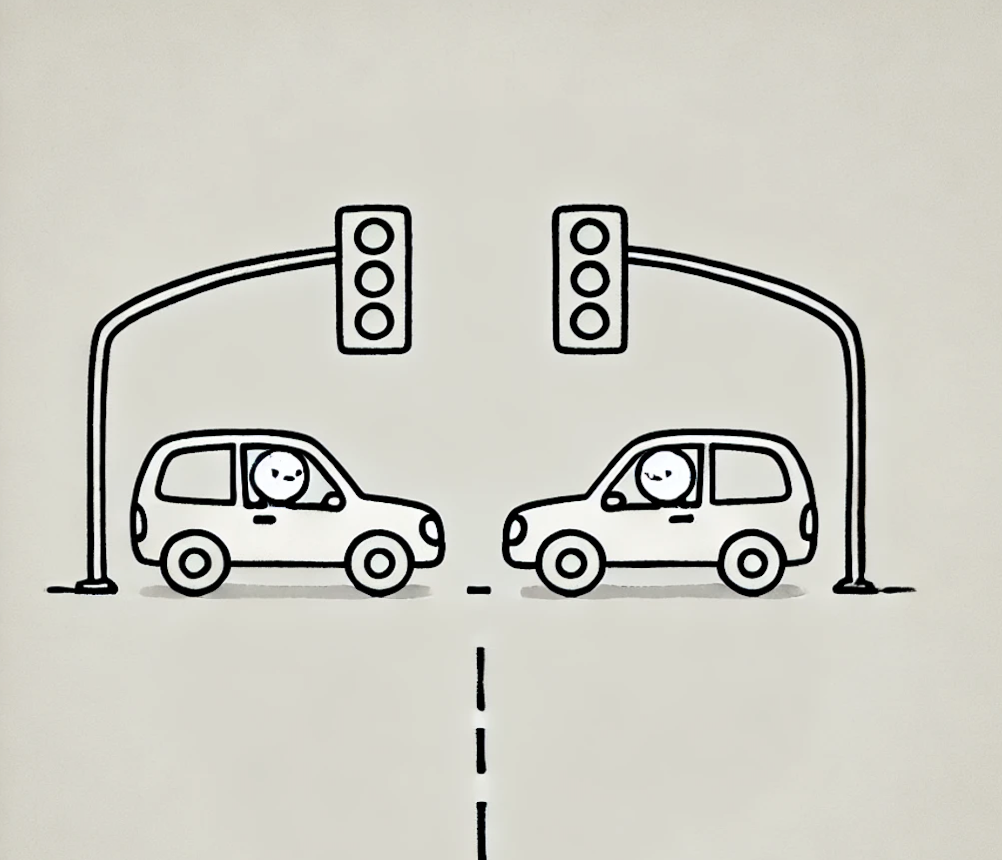
Here’s the upshot
No-swap-regret algorithms have fundamental strategic properties in repeated normal-form games
It was an open question how to define swap regret in more complex games, like Bayesian and extensive-form games
We define a new notion of swap regret that exactly corresponds to these strategic properties in a very broad class of games, and show it can be minimized efficiently.
We show that the two views of correlated equilibria, the mediator view [traffic lights] and the learning view [time-averaged convergence of play] are different beyond normal-form games

Slide 3


Repeated Normal-Form Games
$1
$2
$3
$1
$2
$3

Slide 4
Repeated Normal-Form Games
Time step 1:T
$1
$1
$2
$3
$2
$1
$1
$2
$3
$1
$1
$2
$2
$1
$2
$2
$1
$2
Notes:
Existence implied by the minimax theorem.
Multiple Algorithms exist — including multiplicative weights, Follow-the-Perturbed-Leader, Gradient Descent, etc.
The No-Regret Benchmark – At the end of play, look back over time to benchmark performance against the best fixed action in-hindsight.
If the algorithm is guaranteed to never do (significantly) worse than this benchmark, then it has “no regret”
Efficient algorithms exist even for some problems with large action spaces — such as online shortest path

Slide 5
Repeated Normal-Form Games
Time step 1:T
$1
$1
$2
$3
$2
$1
$1
$2
$3
$1
$1
$2
$2
$1
$2
$2
$1
$2
But what if Natalie wants to use an algorithm to play the game?
Notes:
Existence implied by the minimax theorem.
Multiple Algorithms exist — including multiplicative weights, Follow-the-Perturbed-Leader, Gradient Descent, etc.
The No-Regret Benchmark – At the end of play, look back over time to benchmark performance against the best fixed action in-hindsight.
If the algorithm is guaranteed to never do (significantly) worse than this benchmark, then it has “no regret”
Efficient algorithms exist even for some problems with large action spaces — such as online shortest path

Slide 6
Playing Repeated Normal-Form Games with Algorithms
Example algorithms Natalie could deploy:
Price at $1 for odd round and $2 at even rounds (time-varying)
Price at whatever Eshwar’s price was yesterday (adaptive)
Flip a coin to choose between $1 and $3 every day (randomized)
Notes:
Existence implied by the minimax theorem.
Multiple Algorithms exist — including multiplicative weights, Follow-the-Perturbed-Leader, Gradient Descent, etc.
The No-Regret Benchmark – At the end of play, look back over time to benchmark performance against the best fixed action in-hindsight.
If the algorithm is guaranteed to never do (significantly) worse than this benchmark, then it has “no regret”
Efficient algorithms exist even for some problems with large action spaces — such as online shortest path

Slide 7
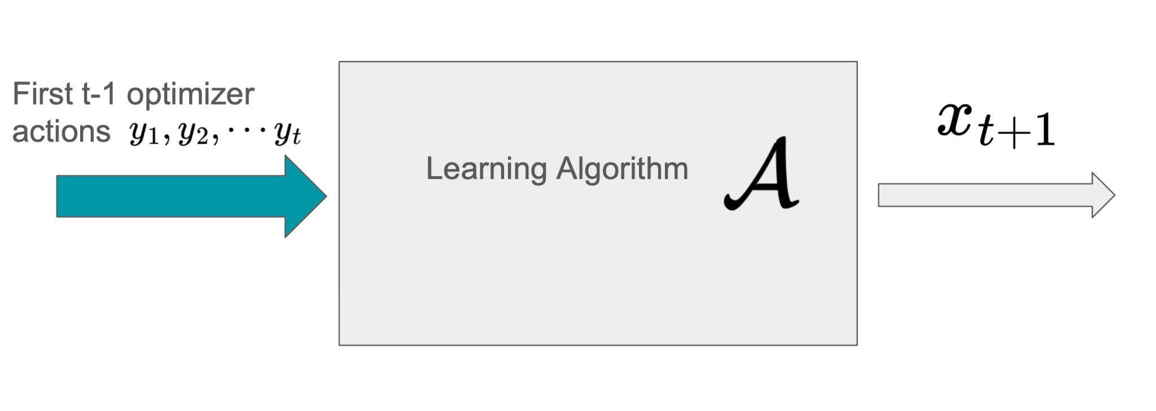
Playing Repeated Normal-Form Games with Algorithms
What is a good algorithm for Natalie to play?
Notes:
Existence implied by the minimax theorem.
Multiple Algorithms exist — including multiplicative weights, Follow-the-Perturbed-Leader, Gradient Descent, etc.
The No-Regret Benchmark – At the end of play, look back over time to benchmark performance against the best fixed action in-hindsight.
If the algorithm is guaranteed to never do (significantly) worse than this benchmark, then it has “no regret”
Efficient algorithms exist even for some problems with large action spaces — such as online shortest path

Slide 8
An answer from Online Learning: No-Regret Algorithms
$1
$1
$2
$3
$2
$1
$1
$2
$3
$1
$1
$2
$2
$1
$2
$2
$1
$2
A no-regret algorithm guarantees that, keeping the opponent’s actions fixed, the external regret to swapping all your actions for the best fixed action is vanishing
Notes:
Existence implied by the minimax theorem.
Multiple Algorithms exist — including multiplicative weights, Follow-the-Perturbed-Leader, Gradient Descent, etc.
The No-Regret Benchmark – At the end of play, look back over time to benchmark performance against the best fixed action in-hindsight.
If the algorithm is guaranteed to never do (significantly) worse than this benchmark, then it has “no regret”
Efficient algorithms exist even for some problems with large action spaces — such as online shortest path

Slide 9
An answer from Online Learning: No-Regret Algorithms
$2
$2
$2
$2
$2
$2
$2
$2
$2
$1
$1
$2
$2
$1
$2
$2
$1
$2
A no-regret algorithm guarantees that, keeping the opponent’s actions fixed, the external regret to swapping all your actions for the best fixed action is vanishing
Notes:
Existence implied by the minimax theorem.
Multiple Algorithms exist — including multiplicative weights, Follow-the-Perturbed-Leader, Gradient Descent, etc.
The No-Regret Benchmark – At the end of play, look back over time to benchmark performance against the best fixed action in-hindsight.
If the algorithm is guaranteed to never do (significantly) worse than this benchmark, then it has “no regret”
Efficient algorithms exist even for some problems with large action spaces — such as online shortest path

Slide 10
An answer from Online Learning: No-Regret Algorithms
$1
$1
$1
$1
$1
$1
$1
$1
$1
$1
$1
$2
$2
$1
$2
$2
$1
$2
A no-regret algorithm guarantees that, keeping the opponent’s actions fixed, the external regret to swapping all your actions for the best fixed action is vanishing
Notes:
Existence implied by the minimax theorem.
Multiple Algorithms exist — including multiplicative weights, Follow-the-Perturbed-Leader, Gradient Descent, etc.
The No-Regret Benchmark – At the end of play, look back over time to benchmark performance against the best fixed action in-hindsight.
If the algorithm is guaranteed to never do (significantly) worse than this benchmark, then it has “no regret”
Efficient algorithms exist even for some problems with large action spaces — such as online shortest path

Slide 11
A refinement of No Regret: No Swap Regret
$1
$1
$2
$3
$2
$1
$1
$2
$3
$1
$1
$2
$2
$1
$2
$2
$1
$2
A no-swap-regret algorithm guarantees that, keeping the opponent’s actions fixed, the swap regret to swapping each your actions for the best fixed action on that subsequence is vanishing
Notes:
Existence implied by the minimax theorem.
Multiple Algorithms exist — including multiplicative weights, Follow-the-Perturbed-Leader, Gradient Descent, etc.
The No-Regret Benchmark – At the end of play, look back over time to benchmark performance against the best fixed action in-hindsight.
If the algorithm is guaranteed to never do (significantly) worse than this benchmark, then it has “no regret”
Efficient algorithms exist even for some problems with large action spaces — such as online shortest path

Slide 12
A refinement of No Regret: No Swap Regret
$1
$1
$2
$3
$2
$1
$1
$2
$3
$1
$1
$2
$2
$1
$2
$2
$1
$2
A no-swap-regret algorithm guarantees that, keeping the opponent’s actions fixed, the swap regret to swapping each your actions for the best fixed action on that subsequence is vanishing
Notes:
Existence implied by the minimax theorem.
Multiple Algorithms exist — including multiplicative weights, Follow-the-Perturbed-Leader, Gradient Descent, etc.
The No-Regret Benchmark – At the end of play, look back over time to benchmark performance against the best fixed action in-hindsight.
If the algorithm is guaranteed to never do (significantly) worse than this benchmark, then it has “no regret”
Efficient algorithms exist even for some problems with large action spaces — such as online shortest path

Slide 13
A refinement of No Regret: No Swap Regret
In general Natalie can play distributions each day, and the notion of swap regret linearly extends
$2
$2
$3
$1
$3
$2
$2
$3
$1
$1
$1
$2
$2
$1
$2
$2
$1
$2
A no-swap-regret algorithm guarantees that, keeping the opponent’s actions fixed, the swap regret to swapping each your actions for the best fixed action on that subsequence is vanishing
Notes:
Existence implied by the minimax theorem.
Multiple Algorithms exist — including multiplicative weights, Follow-the-Perturbed-Leader, Gradient Descent, etc.
The No-Regret Benchmark – At the end of play, look back over time to benchmark performance against the best fixed action in-hindsight.
If the algorithm is guaranteed to never do (significantly) worse than this benchmark, then it has “no regret”
Efficient algorithms exist even for some problems with large action spaces — such as online shortest path

Slide 14
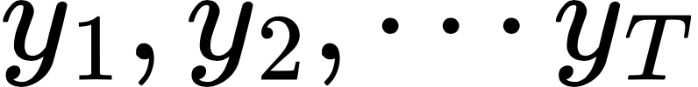
But these properties aren’t satisfying on their own in game-theoretic environments!
Learner
We don’t want “worst-case” guarantees–we want guarantees against someone like Eshwar, strategically optimizing for their own utility
Optimizer
Notes:
What makes learning to play games more tractable than arbitrary adversarial environments?
Opponents behavior might reveal their nature.
With rational opponents, the environment is not arbitrary since they are consistently optimizing for some (potentially unknown) objective.

Slide 15
Playing Repeated Normal-Form Games with Algorithms
Learner
What is a good algorithm for Natalie to commit to in this setting?
Maybe an algorithm that cannot be manipulated by a strategic optimizer
Optimizer
Notes:
Existence implied by the minimax theorem.
Multiple Algorithms exist — including multiplicative weights, Follow-the-Perturbed-Leader, Gradient Descent, etc.
The No-Regret Benchmark – At the end of play, look back over time to benchmark performance against the best fixed action in-hindsight.
If the algorithm is guaranteed to never do (significantly) worse than this benchmark, then it has “no regret”
Efficient algorithms exist even for some problems with large action spaces — such as online shortest path

Slide 16
Non-manipulability
Learner
$1
$1
$1
$1
$1
The best algorithmic response to a non-manipulable algorithm is a static strategy (could be randomized)
Optimizer
Notes:
Existence implied by the minimax theorem.
Multiple Algorithms exist — including multiplicative weights, Follow-the-Perturbed-Leader, Gradient Descent, etc.
The No-Regret Benchmark – At the end of play, look back over time to benchmark performance against the best fixed action in-hindsight.
If the algorithm is guaranteed to never do (significantly) worse than this benchmark, then it has “no regret”
Efficient algorithms exist even for some problems with large action spaces — such as online shortest path

Slide 17
The problem with manipulable algorithms
Learner
BMSW, EC’18:
In a repeated auction setting where a bidder is running a manipulable algorithm, even if it’s no-regret, the auctioneer can extract full welfare from the bidder
$2
$1
$1
$3
$2
Optimizer
Notes:
Existence implied by the minimax theorem.
Multiple Algorithms exist — including multiplicative weights, Follow-the-Perturbed-Leader, Gradient Descent, etc.
The No-Regret Benchmark – At the end of play, look back over time to benchmark performance against the best fixed action in-hindsight.
If the algorithm is guaranteed to never do (significantly) worse than this benchmark, then it has “no regret”
Efficient algorithms exist even for some problems with large action spaces — such as online shortest path
BMSW, EC’18 Mark Braverman, Jieming Mao, Jon Schneider, S. Matthew Weinberg: Selling to a No-Regret Buyer. EC 2018: 523-538

Slide 18
Non-manipulability + No Regret
Learner
$1
$1
$1
$1
$1
Any NM + NR algorithm is guaranteed its Stackelberg follower value against any strategic optimizer!
Optimizer
Notes:
Existence implied by the minimax theorem.
Multiple Algorithms exist — including multiplicative weights, Follow-the-Perturbed-Leader, Gradient Descent, etc.
The No-Regret Benchmark – At the end of play, look back over time to benchmark performance against the best fixed action in-hindsight.
If the algorithm is guaranteed to never do (significantly) worse than this benchmark, then it has “no regret”
Efficient algorithms exist even for some problems with large action spaces — such as online shortest path

Slide 19
No-Swap-Regret Algorithms are non-manipulable!
No Regret Algorithms
Non-manipulable algorithms
This characterizes all No-Swap-regret algorithms!

Slide 20
Upshot for normal-form games:
If you want to have a no-regret non-manipulable algorithm, you can just run any off-the shelf worst-case no-swap-regret algorithm
There exist algorithms with convergence rates and runtimes that are efficient in the number of actions and the number of time steps T

Slide 21
Ok, that’s a great story for Repeated Normal-Form Games
Price:
$1
$2
$3
Price:
$1
$2
$3

Slide 22
But what about, say, Repeated Bayesian Games?
Price:
$1
$2
$3
Price:
$1
$2
$3
$0
$1
Context = cost of production:
$1
$1
$0
$1
$2
Natalie’s strategy is now a mapping from contexts to actions
$2
$2
Exogenous distribution over contexts

Slide 23
What should we “swap” here?
$0
$1
$0
$1
$0
$3
$0
$1
$1
$1
$1
$1
$1
$3
$1
$2
$2
$2
$2
$2
$2
$3
$2
$2
$1
$2
$2
$2
One option: Swap all mapping structures to the optimal mapping structure
Notes:
Existence implied by the minimax theorem.
Multiple Algorithms exist — including multiplicative weights, Follow-the-Perturbed-Leader, Gradient Descent, etc.
The No-Regret Benchmark – At the end of play, look back over time to benchmark performance against the best fixed action in-hindsight.
If the algorithm is guaranteed to never do (significantly) worse than this benchmark, then it has “no regret”
Efficient algorithms exist even for some problems with large action spaces — such as online shortest path

Slide 24
What should we “swap” here?
$0
$1
$0
$1
$0
$3
$0
$1
$1
$1
$1
$1
$1
$3
$1
$2
$2
$2
$2
$2
$2
$3
$2
$2
$1
$2
$2
$2
One option: Swaps between mapping structures
Notes:
Existence implied by the minimax theorem.
Multiple Algorithms exist — including multiplicative weights, Follow-the-Perturbed-Leader, Gradient Descent, etc.
The No-Regret Benchmark – At the end of play, look back over time to benchmark performance against the best fixed action in-hindsight.
If the algorithm is guaranteed to never do (significantly) worse than this benchmark, then it has “no regret”
Efficient algorithms exist even for some problems with large action spaces — such as online shortest path

Slide 25
What should we “swap” here?
$0
$3
$0
$3
$0
$1
$0
$1
$1
$2
$1
$2
$1
$2
$1
$3
$2
$2
$2
$2
$2
$3
$2
$3
$1
$2
$2
$2
One option: Swaps between mapping structures
Notes:
Existence implied by the minimax theorem.
Multiple Algorithms exist — including multiplicative weights, Follow-the-Perturbed-Leader, Gradient Descent, etc.
The No-Regret Benchmark – At the end of play, look back over time to benchmark performance against the best fixed action in-hindsight.
If the algorithm is guaranteed to never do (significantly) worse than this benchmark, then it has “no regret”
Efficient algorithms exist even for some problems with large action spaces — such as online shortest path

Slide 26
What should we “swap” here?
$0
$3
$0
$3
$0
$1
$0
$1
$1
$2
$1
$2
$1
$2
$1
$3
$2
$2
$2
$2
$2
$3
$2
$3
$1
$2
$2
$2
One option: Swaps between mapping structures
This gets non-manipulability + NR, but the number of different subsequences could now be exponential in the number of contexts!
Notes:
Existence implied by the minimax theorem.
Multiple Algorithms exist — including multiplicative weights, Follow-the-Perturbed-Leader, Gradient Descent, etc.
The No-Regret Benchmark – At the end of play, look back over time to benchmark performance against the best fixed action in-hindsight.
If the algorithm is guaranteed to never do (significantly) worse than this benchmark, then it has “no regret”
Efficient algorithms exist even for some problems with large action spaces — such as online shortest path

Slide 27
What should we “swap” here?
Distribution over contexts
$0
$3
Distribution over actions
$1
$2
$2
$2
$1
$2
$2
$2
Another option: Swaps between the downstream actions
This doesn’t achieve non-manipulability! Or even external regret to the best mapping structure
Notes:
Existence implied by the minimax theorem.
Multiple Algorithms exist — including multiplicative weights, Follow-the-Perturbed-Leader, Gradient Descent, etc.
The No-Regret Benchmark – At the end of play, look back over time to benchmark performance against the best fixed action in-hindsight.
If the algorithm is guaranteed to never do (significantly) worse than this benchmark, then it has “no regret”
Efficient algorithms exist even for some problems with large action spaces — such as online shortest path

Slide 28
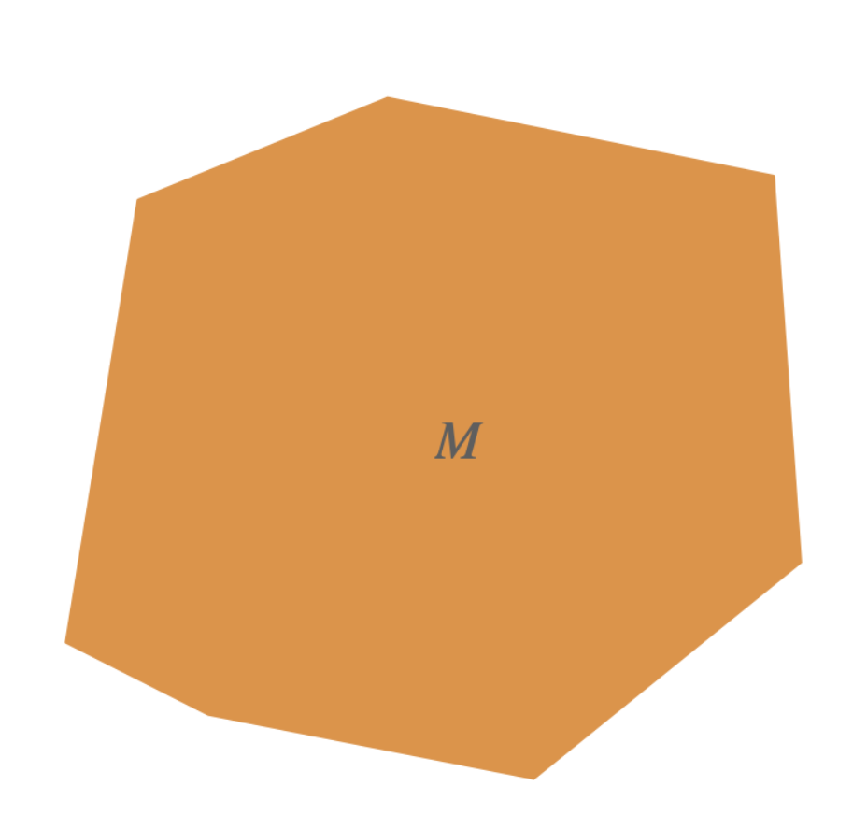
We need a new tool to think about this!
What’s the tool?
Menus! A geometric interpretation of algorithms for repeated games.

Slide 29
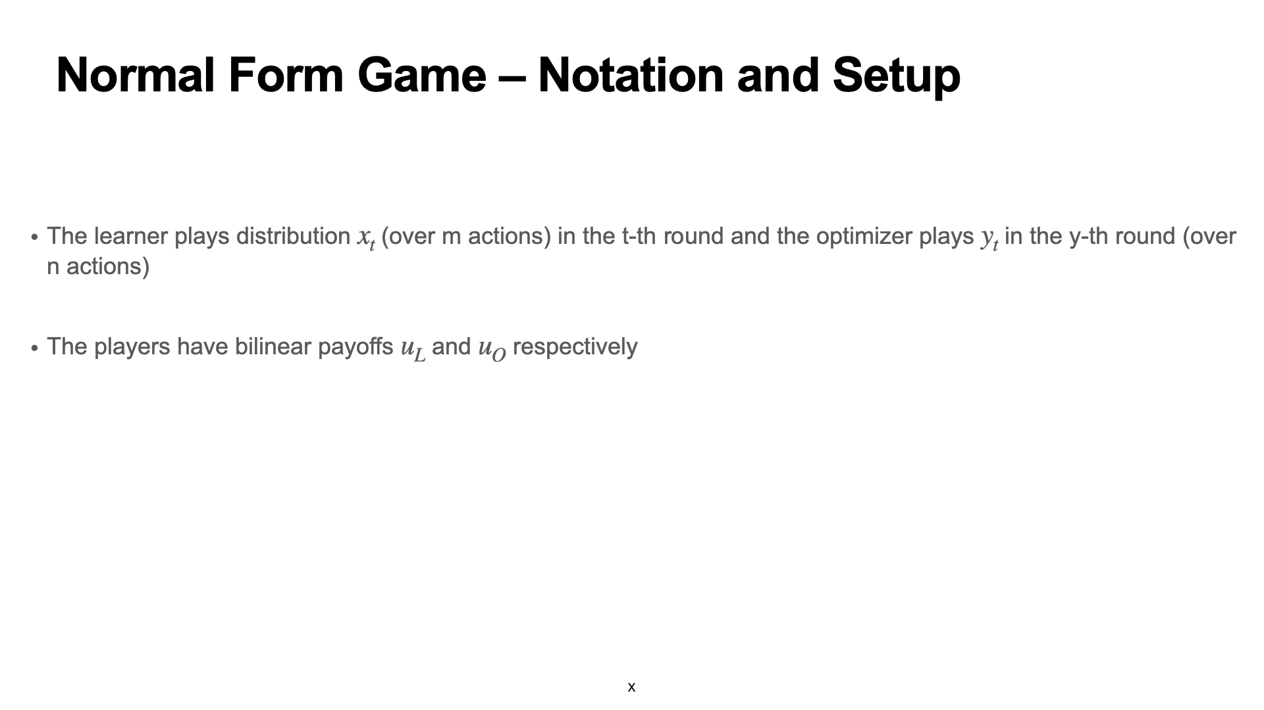
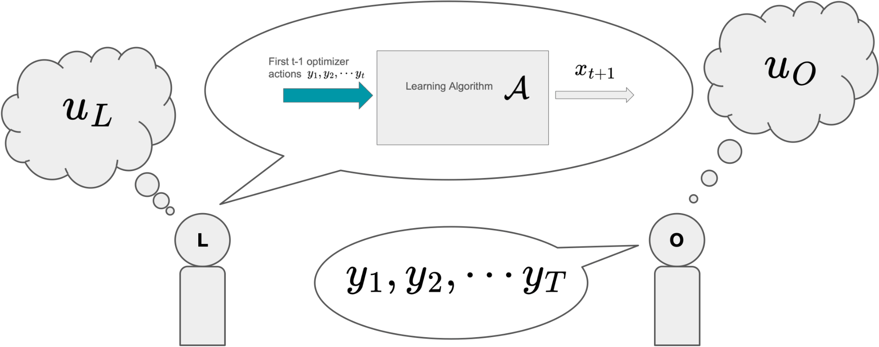

Slide 30
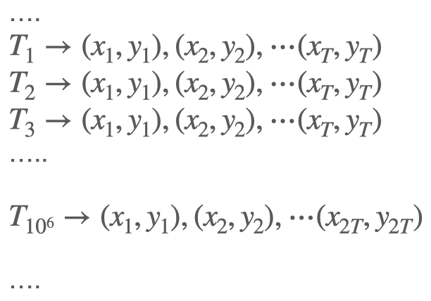
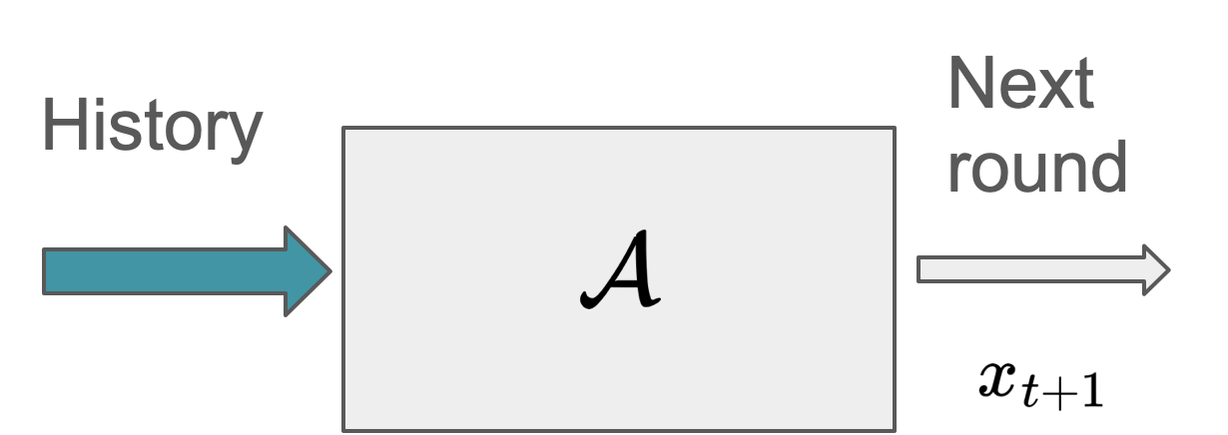
Representing Algorithmic Strategies
Traditional Definition: Mapping histories to actions
Alternative Definition
All Possible Transcripts of Play (for each sequence length)
For eg: A No-Regret algorithm must be entirely composed of transcripts satisfying the no-regret property.

Slide 31
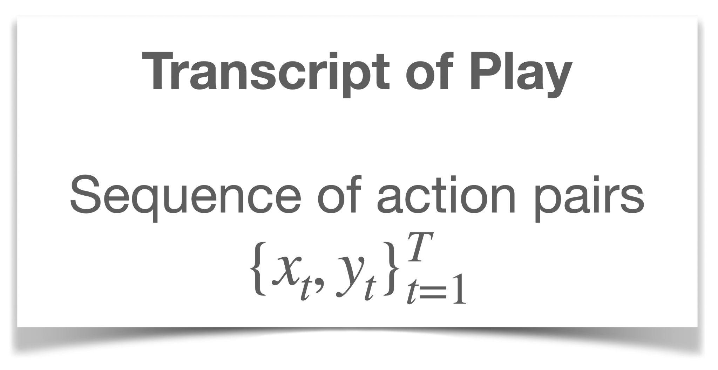
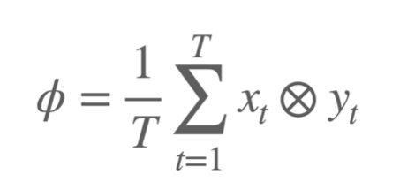
Compressing Transcripts
(Lossy) Transformation of transcript to Correlated Strategy Profile (CSP)
Quantities Preserved
Learner and Optimizer Payoffs
Learner Regret/ swap-regret
Correlated Strategy Profile
Empirical Distribution over action pairs (action products)
CSPs are the same type of object as Correlated Equilibria

Slide 32
Transcripts to CSPs
$1
$1
$2
$2
$2
$1
$1
$2
$1
$1
$1
$2
$1
$1
$1
$2
50%
25%
25%
$1
$1
$2
$1
$2
$2
And similarly with products of distributions

Slide 33
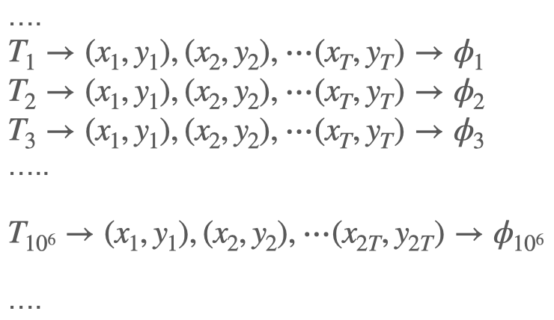
Representing Algorithmic Strategies
Traditional Definition: Mapping histories to actions
Alternative Definition
All Possible CSPs induced
For eg: A No-Regret algorithm must only result in CSPs that satisfy the no-regret property

Slide 34
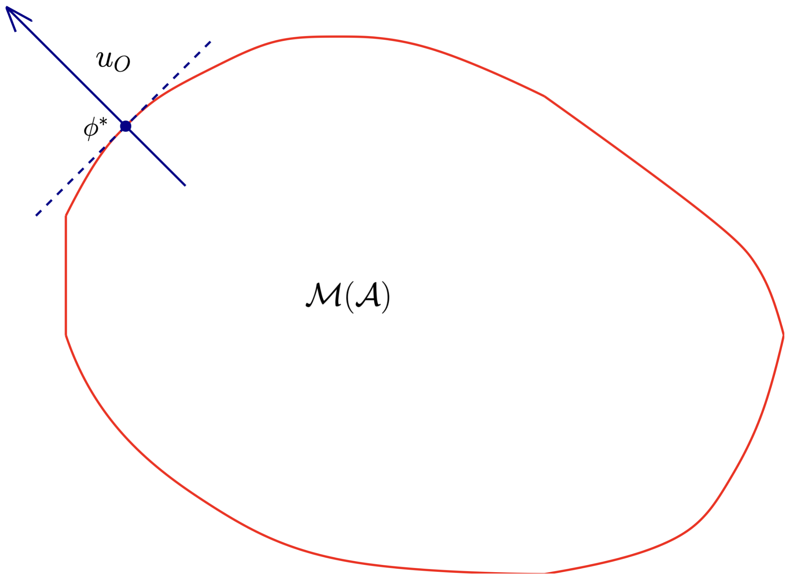
Algorithms -> Menus
The convex hull of all limit CSPs that can be induced by playing against algorithm A
Menus drop some information, but simplify the problem by only preserving outcomes without telling us how to get them.
PS: Rational Opponents only pick extreme points!
Each point in the menu is a CSP , that records the empirical statistics of some transcript of play against this algorithm.

Slide 35
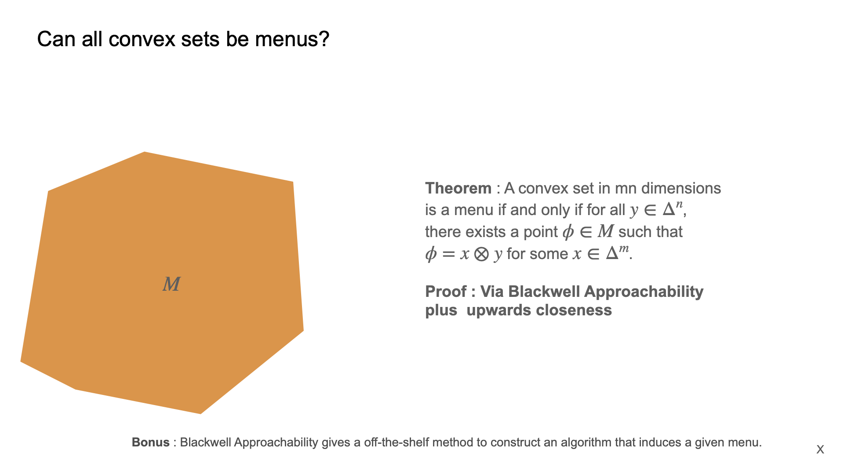
Can all convex sets be menus?
Theorem : A convex set in mn dimensions is a menu if and only if for all distributions y of the optimizer, there exists a point in the menu for some action x of the learner. (INCOMPLETE)
Proof : Via Blackwell Approachability plus upwards closeness (all supersets of menus are menus)
Bonus : Blackwell Approachability gives a off-the-shelf method to construct an algorithm that induces a given menu.

Slide 36
No-Regret and Non-Manipulable Menus
No Regret Menus
Non-manipulable Menus
What Lies here?

Slide 37
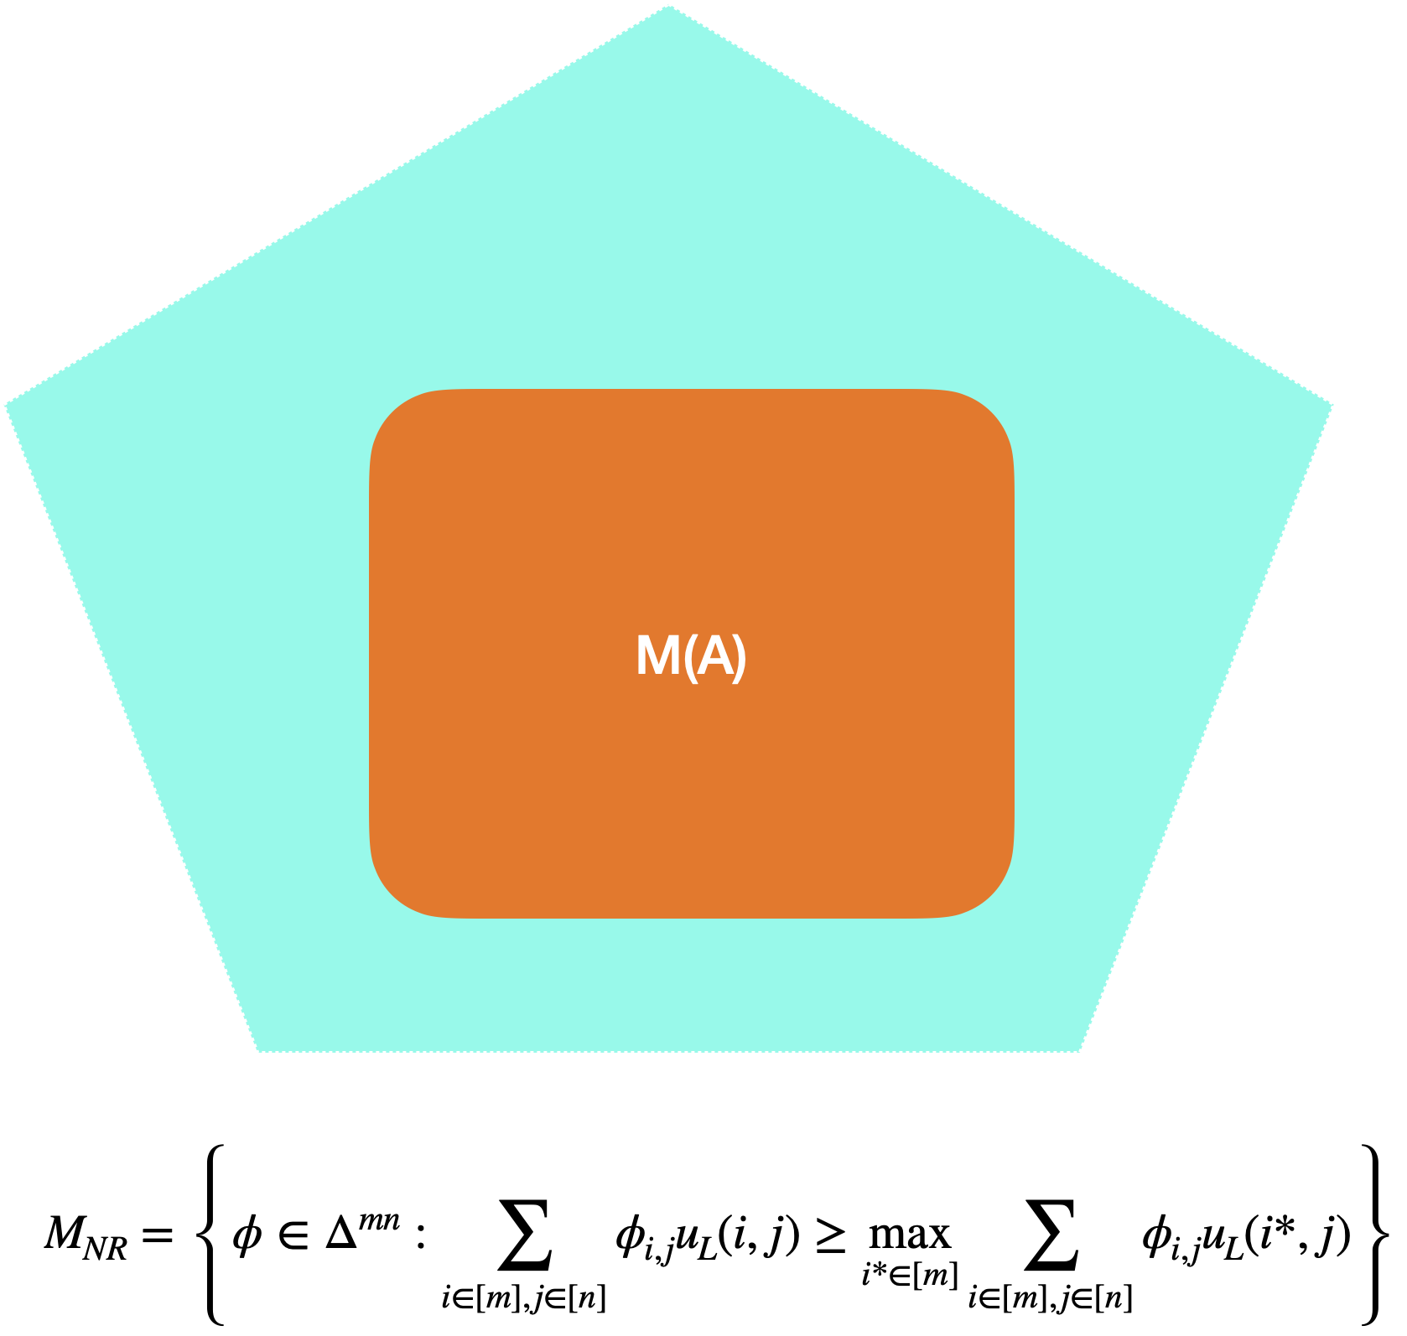
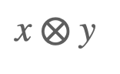
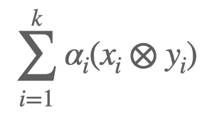
Strategic Properties via Menus
No-Regret Menus
Non-Manipulable Menus
All extreme points of any non-manipulable algorithm’s menu must be of the form
Note that in general - CSPs need not be products, they are generally of the form –

Slide 38
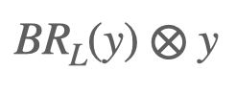
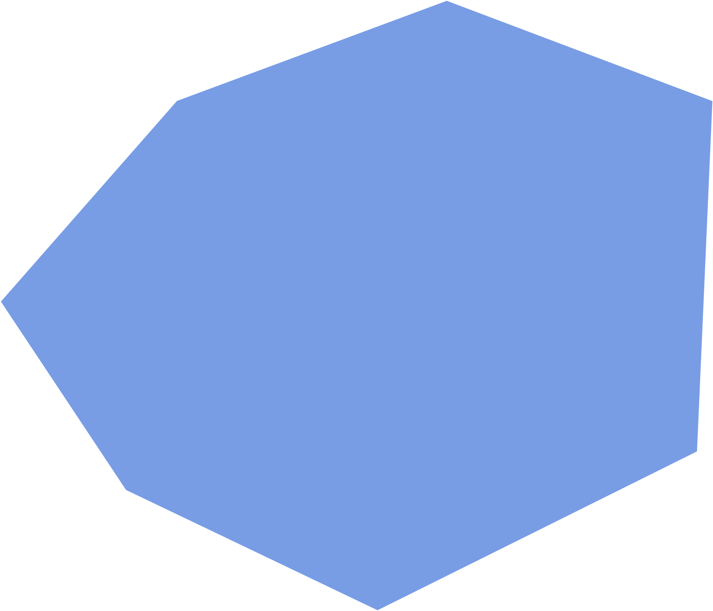
There is a Unique NR + NM Menu M*
Lemma : The unique NR+NM menu M* is the convex hull of all points of the form

Slide 39
All NR + Non Manipulable algorithms in normal form games have the SAME MENU M*!
All extreme points are product distributions
Applying the NR condition to the product CSPs is straightforward.
No-Regret
Additionally, any menu must contain a CSP for each action y.

Slide 40
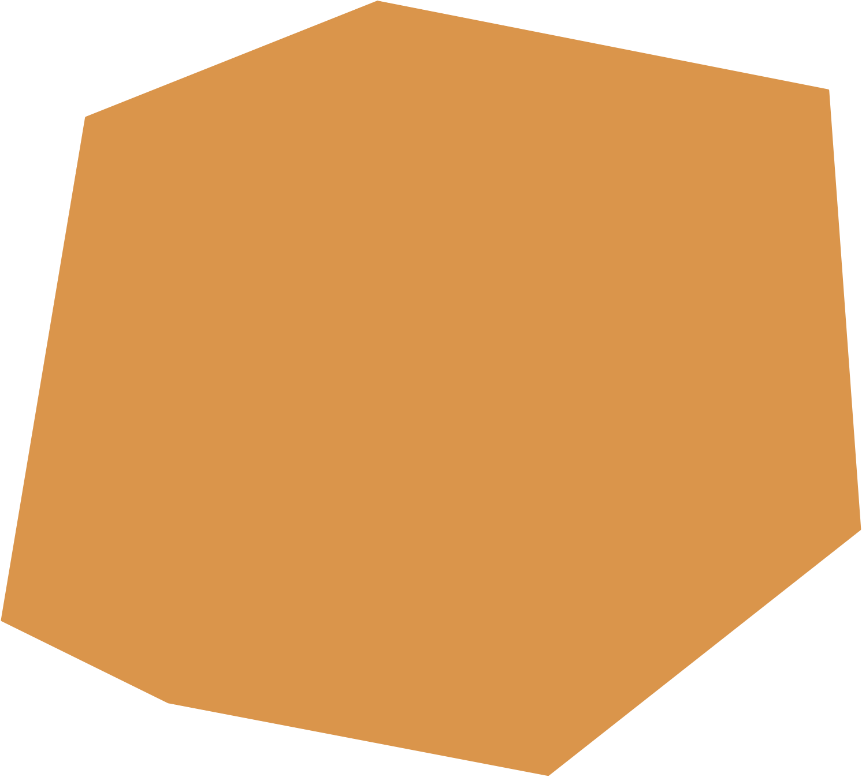
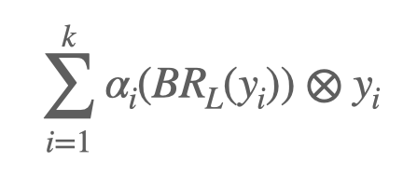
This Unique Menu M* is also the menu of all NSR Algorithms!
Main Idea: All NSR menus are contained within M*.
But not hard to show that M* is an inclusion minimal menu.
Optimal Swap Function

Slide 41
Big Takeaway
Thinking of strategic menus gives an alternative pathway to NSR algorithms.
In particular, an equivalent definition of swap-regret is distance to the unique strategic menu M*.
This is important for polytope games.

Slide 42
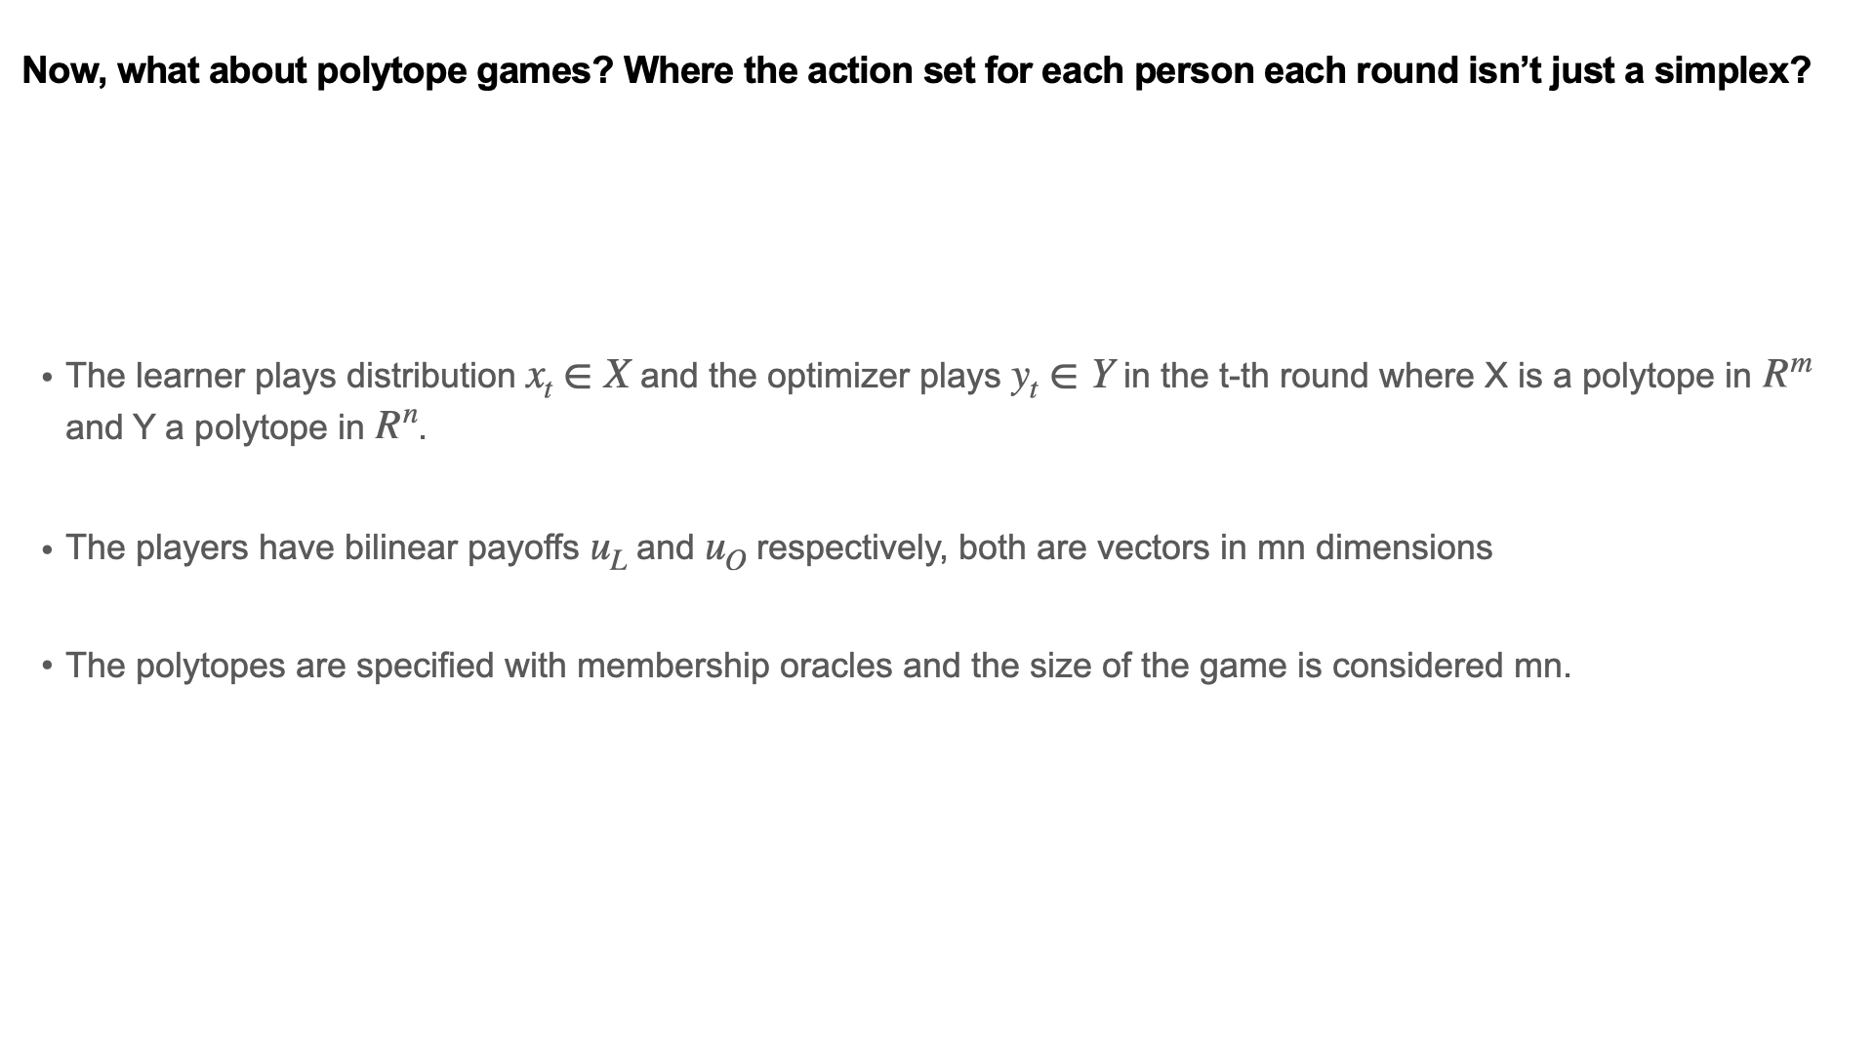

Slide 43
Normal-Form Games vs. Polytope Games
Normal-form games
Polytope games
In each round, agents choose actions within simplices
In each round, agents choose actions within polytopes
Interpretation: probability distribution over pure actions
Interpretation(s): Numerous!
Action 1
Action 2

Slide 44
Normal Form Games
The unique interpretation of action (½, ½) is as a coin flip/ convex combination between the two “pure strategies”
x1
x2

Slide 45
Polytope Games
The action (½, ½) admits more than one interpretation, for example, there are multiple ways of writing it as a convex combination/ coin flip between two vertices of the polytope.

Slide 46
Polytope Games
How should we record joint play?
The action (½, ½) admits more than one interpretation, for example, there are multiple ways of writing it as a convex combination/ coin flip between two vertices of the polytope.

Slide 47
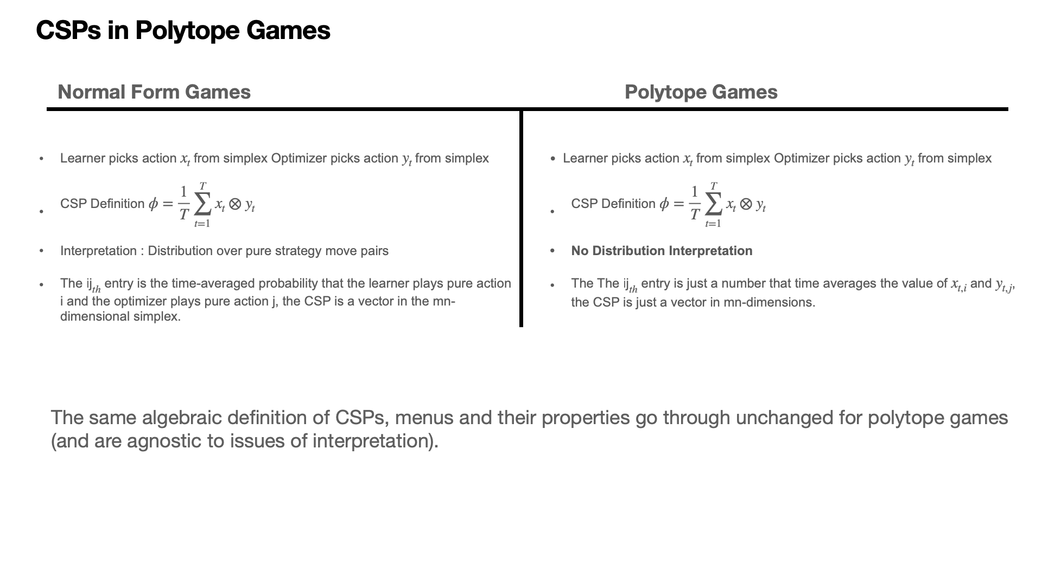

Slide 48
Polytope Games : There is a Unique NR + NM Menu M*
Same lemma : The unique NR+NM menu M* is the convex hull of all points of the form

Slide 49
Defining Swap-Regret for Polytope Games
There is a unique menu M* achieving NR + NM.
Define Profile Swap-Regret as distance to the unique strategic menu M*.

Slide 50
Efficient Algorithms for Semi-separation
This new notion of swap-regret is necessary and sufficient for the strategic properties.
Is its menu M* efficiently approachable? Not obvious since it’s NP-hard to check membership in M*!
A recent result of [DFFPS], STOC 25 allows us to use the certificate of approachability to construct an efficient algorithm approaching this set.
Notes:
Constantinos Daskalakis, Gabriele Farina, Maxwell Fishelson, Charilaos Pipis, Jon Schneider: Efficient Learning and Computation of Linear Correlated Equilibrium in General Convex Games. STOC 2025: 542-553

Slide 51
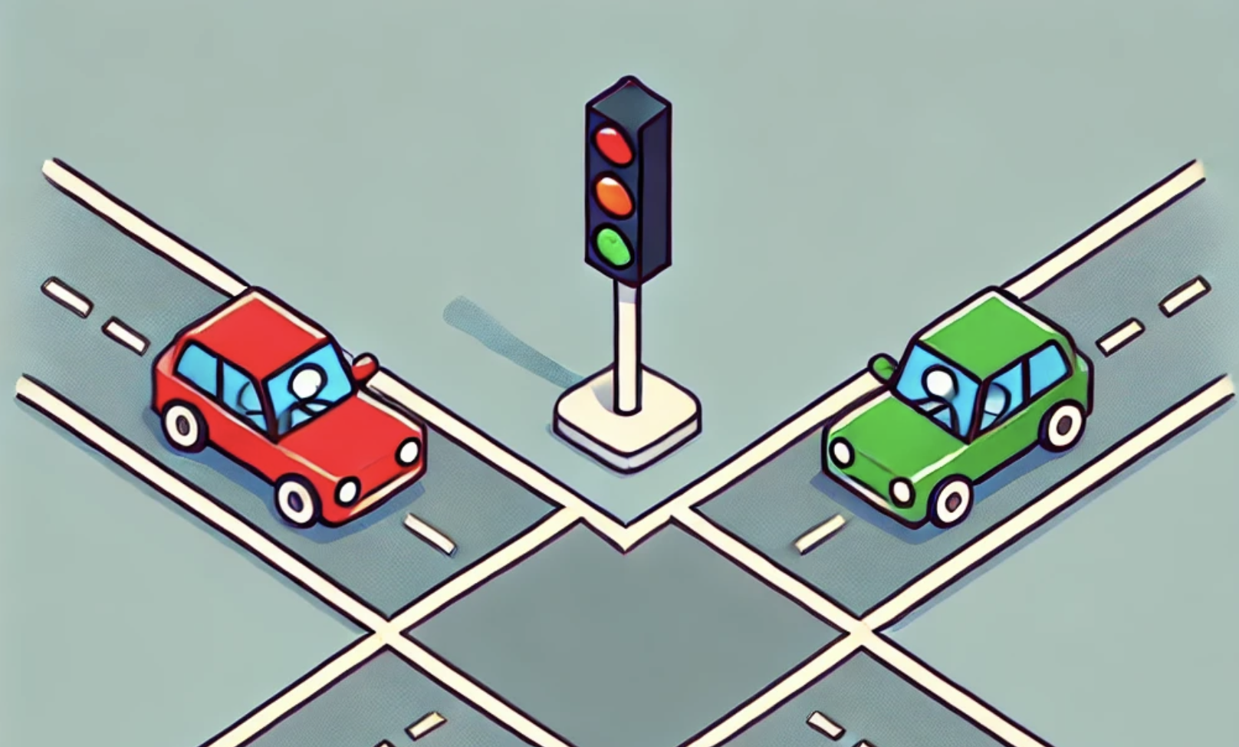
Correlated Equilibria
Mediator View
Learning View
CSP implementable via a mediator recommending correlated strategies
Time-averaged CSP between any two no-swap-regret algorithms
In normal-form games, the set of “mediator” correlated equilibria and “learning” correlated equilibria are exactly the same
This is in fact the way no-swap regret algorithms were first conceptualized
But in polytope games (even just Bayesian games), these notions are different!
Notes:
In normal form games there’s this equivalence between a mediator protocol and strategic play between agents
NOT SO in more general games
Even moving just to Bayesian games–the set of payoff profiles that can be achieved when they are responding to a mediator who tells them both mappings from states to actions is strictly smaller than the set of payoff profiles that can be achieved when they both play no-regret non-manipulable algorithms against each other

Slide 52
Here’s the upshot again :)
No-swap-regret algorithms have fundamental strategic properties in repeated normal-form games
It was an open question how to define swap regret in more complex games, like Bayesian and extensive-form games
We define a new notion of swap regret that exactly corresponds to these strategic properties in a very broad class of games, and show it can be minimized efficiently.
We show that the two views of correlated equilibria, the mediator view [traffic lights] and the learning view [time-averaged convergence of play] are different beyond normal-form games

Slide 53

The End! Thanks!

Slide 54
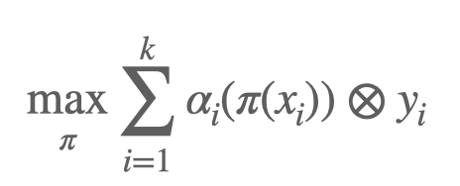
Profile Swap Regret (the swap interpretation)
Basic Idea : Apply the swap function to the learner’s side of the CSP
The Catch : Multiple decompositions of the CSP due to the polytopes.

Slide 55
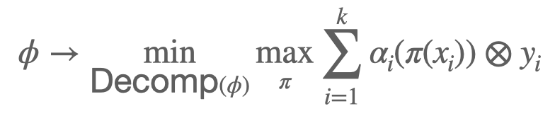
Profile Swap Regret (the swap interpretation)
Basic Idea : Apply the swap function to the learner’s side of the CSP
The Fix : Measure the swap-regret of a CSP over the decomposition that minimizes the resulting swap-regret, i.e. we need only a single certificate of no-swap-regret

Slide 56
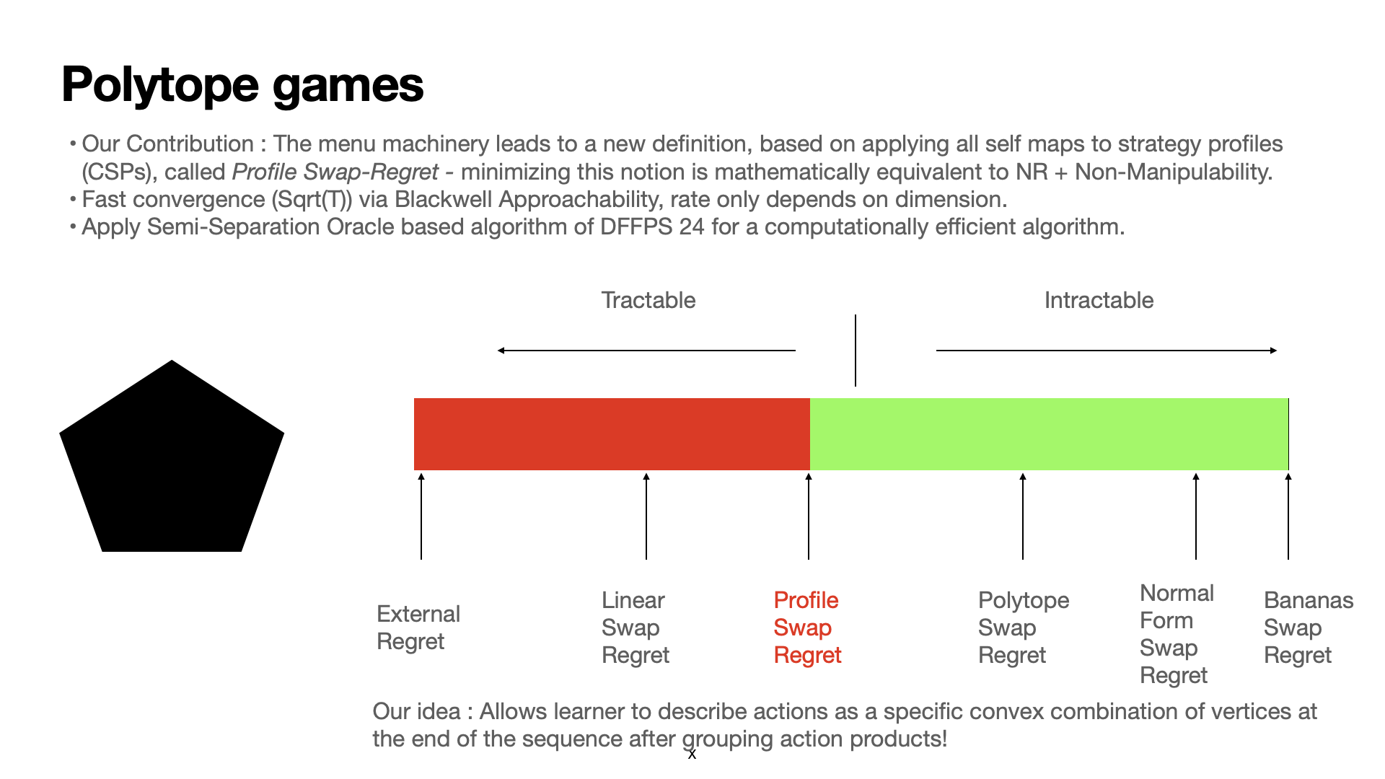
Polytope Games
x1
X
y1
x2
y2

